Slide 1


Wastewater Treatment Facility Improvements Project
Water Works Commission
Wausau, WI
June 25, 2019

Slide 2
The Project Overview and Status Report

Slide 3
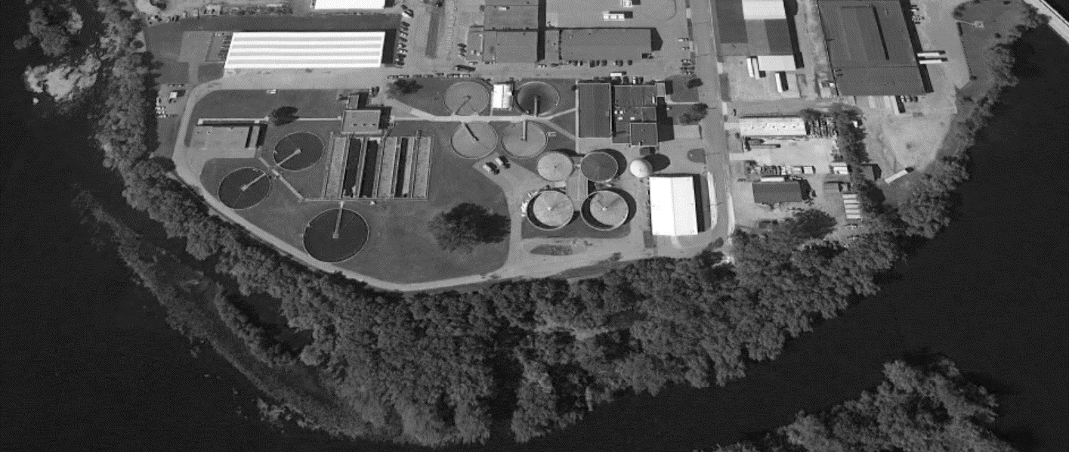
Project will Address an Aging Facility
1939
1967
1988
80+ Years Old
50+ Years Old
30+ Years Old

Slide 4
One of Wausau’s Most Valuable Assets
Potential Value = $175M*
* Based on recent new 24-mgd nutrient-removing treatment facility for Denver, CO. Grand opening 2017. Cost = $417M.
[CCI 2018 = 10,959. CCI 2011 = 9070. Cost = $504M in $2018. Includes a 7-mile forcemain.]

Slide 5
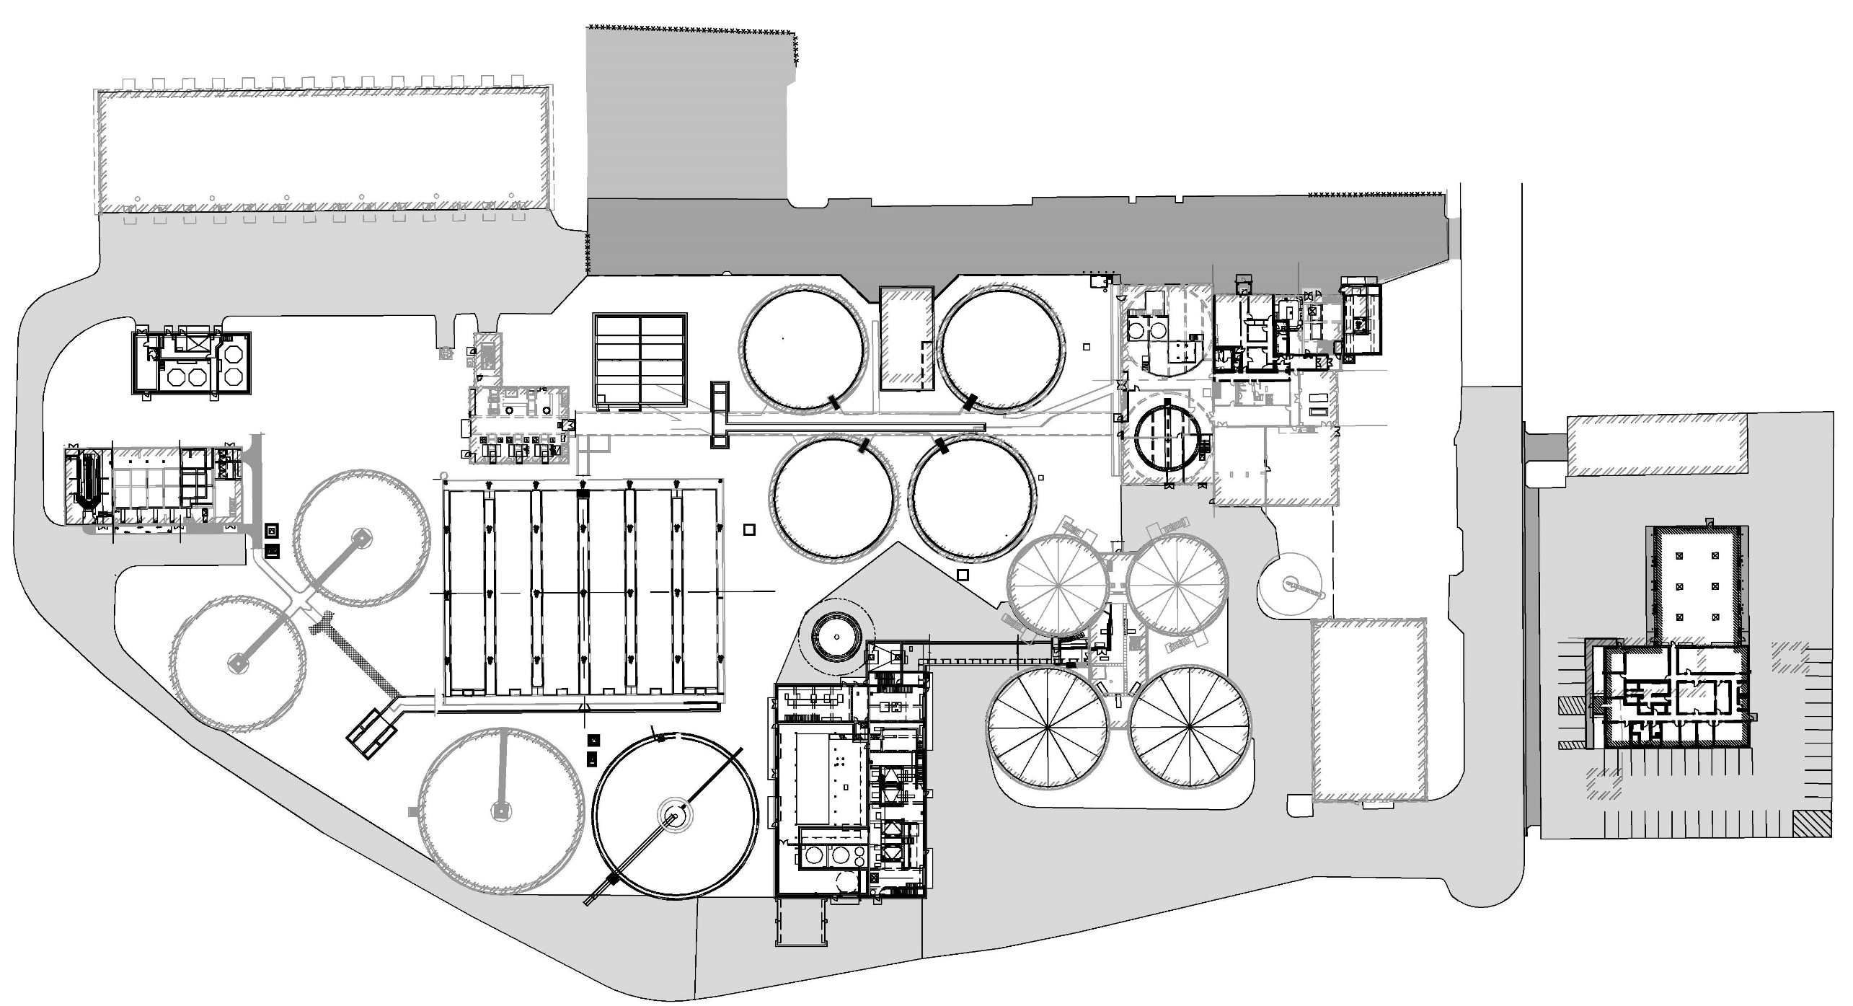
Repurpose
Upgrade
New
Alternate

Slide 6
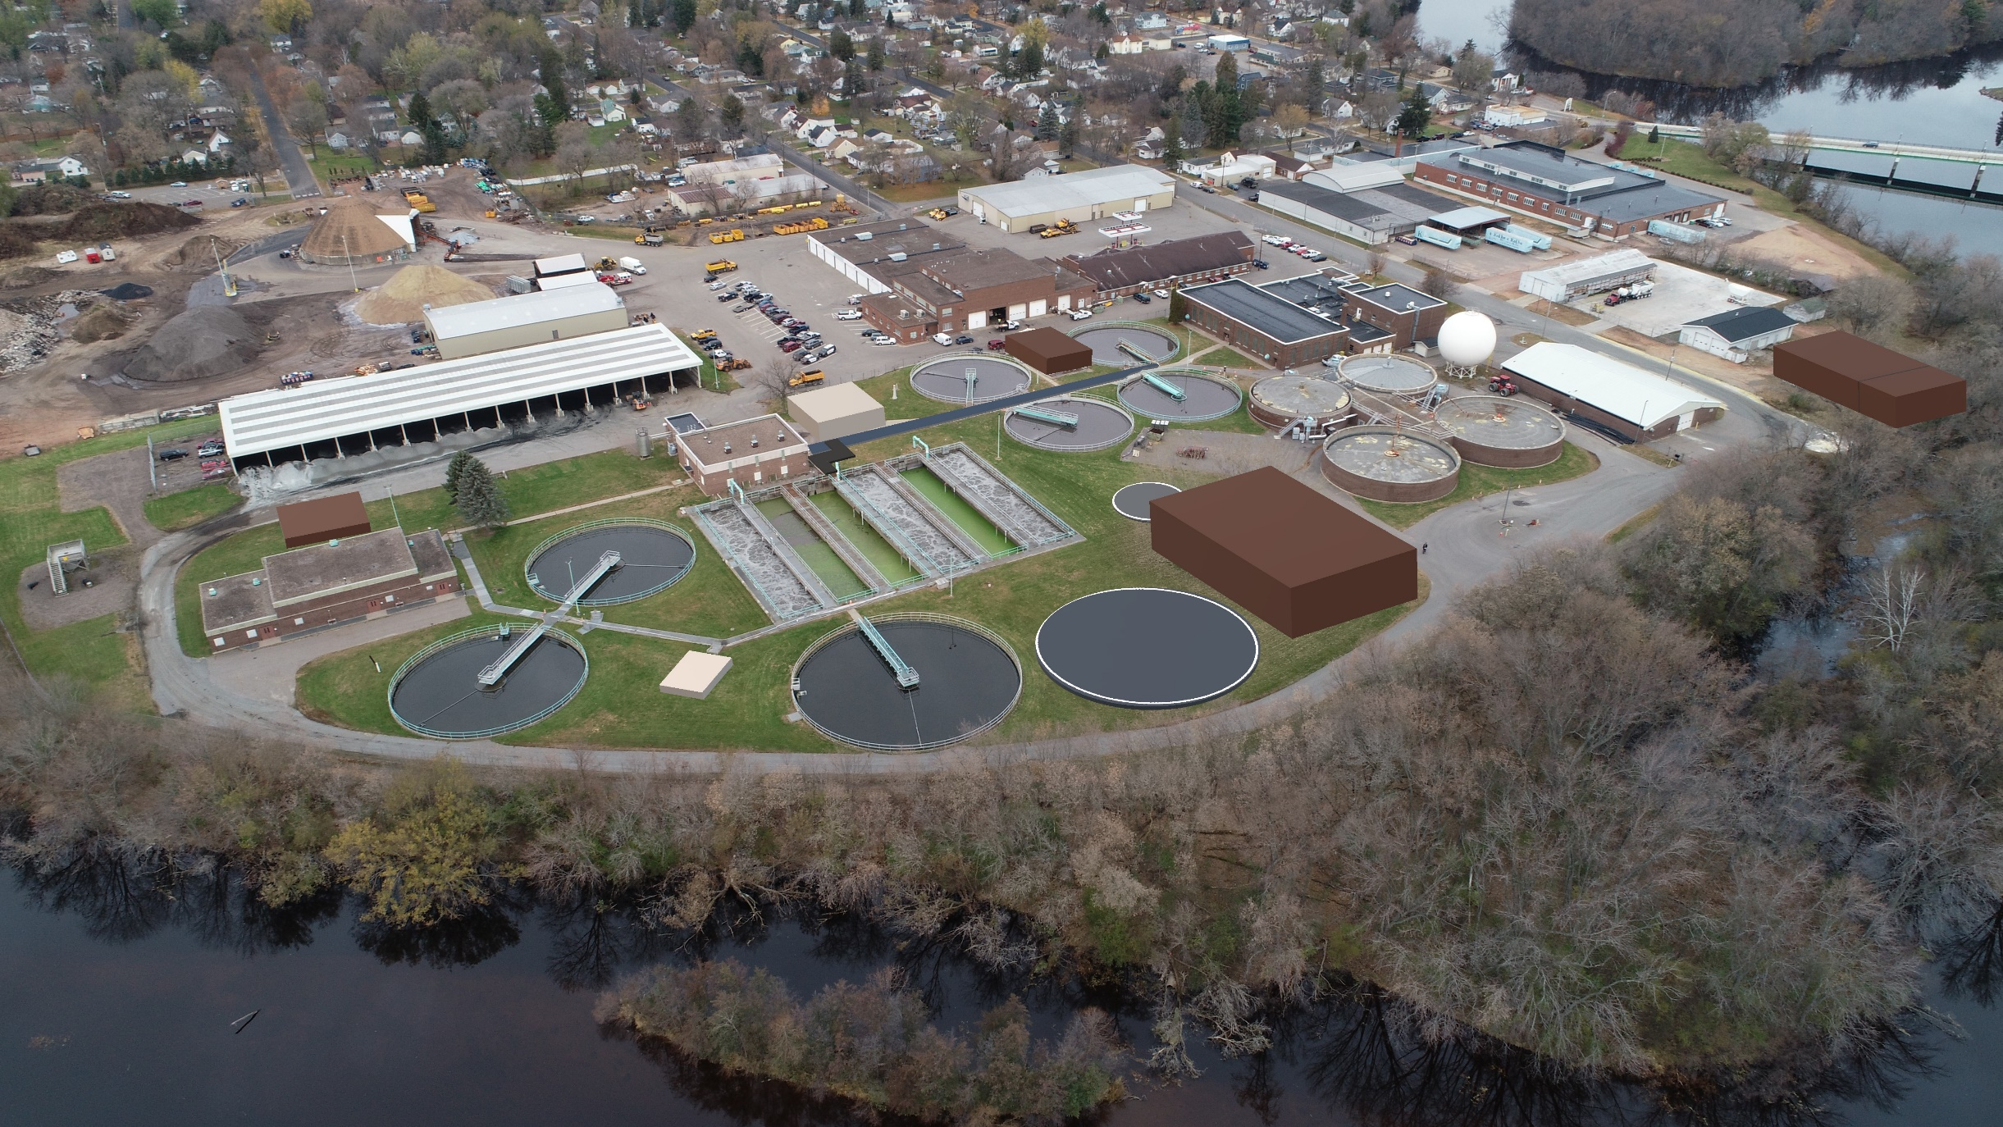
Simple Site Rendering Showing New Structures
A/S Selector
Solids Processing
Administration/Lab
Chemical Storage
Flow Splitting
Secondary
(Alternate)

Slide 7
Comprehensive Project to Address Passage of Time Since Last Major Upgrade
Equipment and Infrastructure
Water Quality Regulations (Phosphorus)
Safety Regulations (Fire and Explosions)
Biosolids Land Application Logistics and Cost Avoidance

Slide 8
Schedule
Submit CWF Application and
Plans/Specs to WDNR
Sep 30
Bids
Loan Closing
First Loan Draw
Begin Loan Re-Payment
2018 |  |  |  | 2019 |  |  |  | 2020 |  |  |  | 2021 |  |  |  | 2022
Q1 | Q2 | Q3 | Q4 | Q1 | Q2 | Q3 | Q4 | Q1 | Q2 | Q3 | Q4 | Q1 | Q2 | Q3 | Q4 | Q1 | Q2 | Q3 | Q4
Facility Plan
Preliminary Layout Design
Detailed Design
Bid
Construction
Submitted Final Facility Plan to WDNR
Final Layout Drawings and Operating Strategies Complete. Design Advances to Specifications and Fine Details.
Phased Rate Increase

Slide 9
After the Improvements are Operational

Slide 10
Effluent Quality will Improve

Slide 11
Historical Effluent BOD Data

Slide 14
Dec 31, 2025

Slide 15
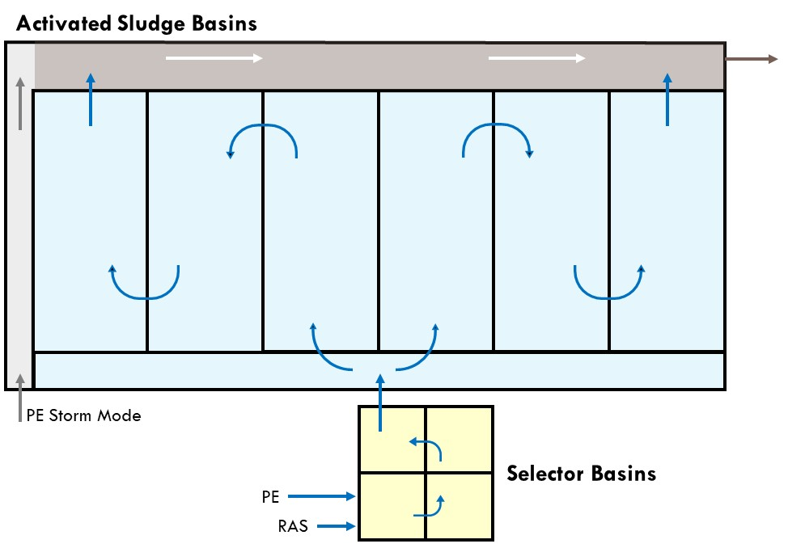
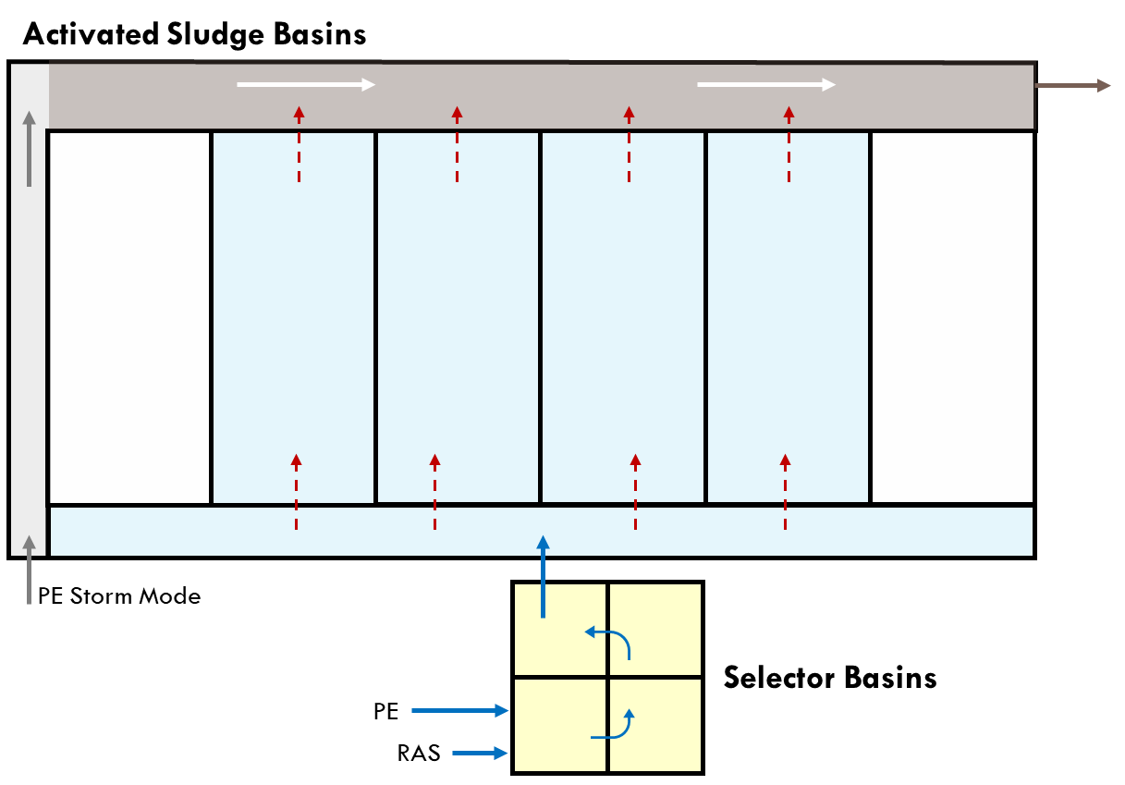
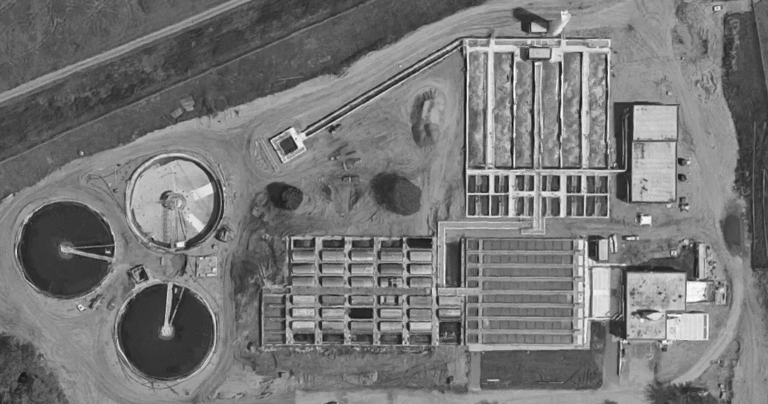

Mode A | Exceptional Effluent Quality and Stability
Mode B | Sufficient Effluent Quality, Poor Stability
Eau Claire
Mode A is the preferred method to operate; however, it can cost more to operate than Mode B. It can be more energy intensive. The primary concern is alkalinity.
Wausau

Slide 17
Activated Sludge System: Minimize Operating Cost for Required Operating Mode
Operating Mode Flexibility ► Match Mode (Cost) to Required Performance
Efficient Aeration System ► Minimize Aeration Energy
  Equipment, Configuration, and Automation
Nitrate Utilization ► Minimize Aeration Energy, Supplemental Alkalinity
  Reduce Aeration Requirement
  Enhance Alkalinity Recovery
Enhance Biological Phosphorus Removal ► Reduce Chemicals
  Balance with Biosolids Operating Cost
Chemical Feed Automation► Reduce Chemicals
$
Performance
Flexibility and Provisions to Maximize Efficiency

Slide 18
Biosolids Logistics will Improve

Slide 19
Biosolids Logistics will Improve
Produce Dry Class A EQ Material that is Unregulated
Investigating Potential Outlets
  Hsu Growing Supply – Produce a Product Bagged or Bulk [e.g., WauSoil]
    Initial Conversation Encouraging: Interested
    Donohue Provided Information and Samples
    Next Steps: Provide Samples, Tour a Drying Facility
  Marathon County Landfill – Meeting in Early July | Free Daily Cover
  Local Fertilizer Dealers/Co-Ops – Future Conversations
  Large Local Cash Croppers [High Confidence] – Future Conversations
Rothschild Biomass Plant
  WDNR Permit Precludes Municipal Solid Waste and Biosolids

Slide 20
Equipment and Automation Strategies will Enhance Efficiency

Slide 21
Equipment will be More Efficient
Electrical Equipment – Focus on Energy Funding
  LED Lights, Premium Efficiency Motors, VFDs, Automation
Gas-Consuming Equipment – Focus on Energy Funding
  High Efficiency Dual-Fuel and Natural Gas Boilers
Process Automation
  Electricity
  Chemicals
  Labor
Efficient HVAC Strategies
  Recover Some Blower Heat | Fresh Air for Tunnel and Digester Complex

Slide 22
Ventilation Rates will Increase

Slide 23
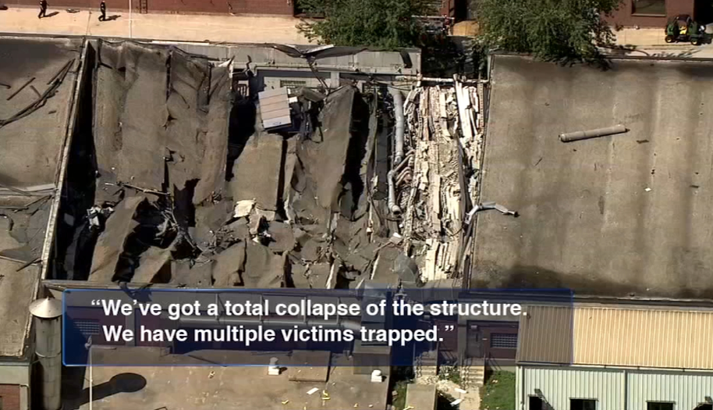
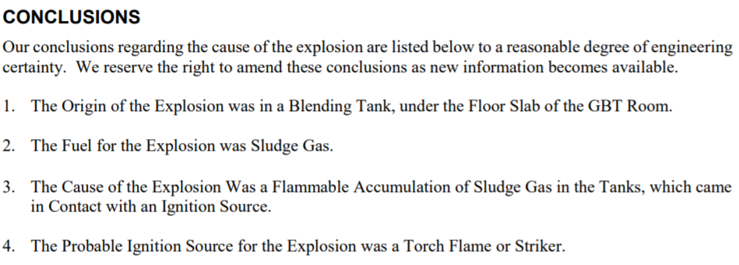
Ventilation Rates will Increase
NFPA 820
Standard for Fire Protection in Wastewater treatment and Collection Facilities
Preliminary Treatment 12 ac/hr
Gas Handling 12 ac/hr
Biosolids Building 6 ac/hr [dewatering, screening, and pumping]
Digester Complex 6 ac/hr
Tunnel 6 ac/hr

Slide 24
Near-Term Maintenance Spending will Decrease

Slide 25
Initial Annual Cost Accounting

Slide 26
Developing a Sustainable Design

Slide 27
Deliberately Focus on Cost-Effective Sustainability Practices
Meeting Mid-to-Late July
  Discuss and Adopt Sustainability Concepts

Slide 28
Thank You

