Slide 1


A Wastewater Project Update
Utility Commission
Wausau, WI
September 4, 2018

Slide 2
The Wausau Wastewater Treatment Facility

Slide 3
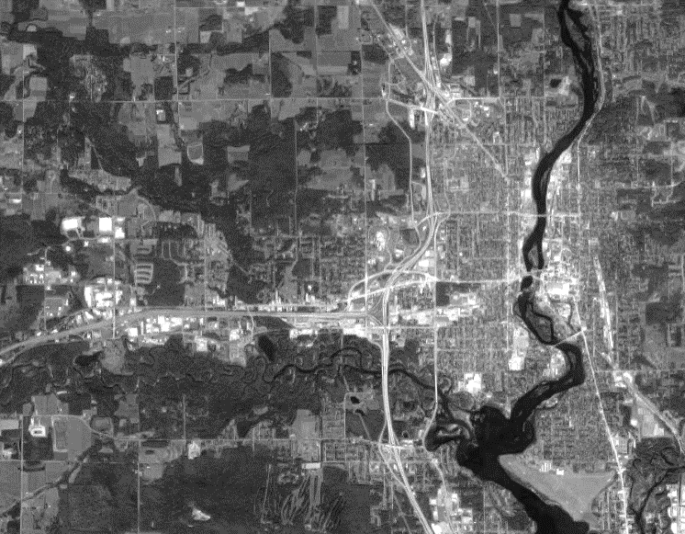
Its Located Near the City’s Southern Boundary on Adrian Street

Slide 4
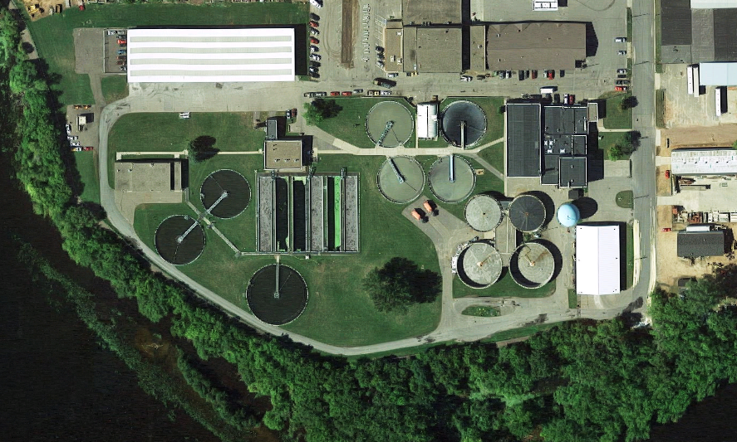
Its Located Near the City’s Southern Boundary on Adrian Street

Slide 5

It Receives All Wastewater from Wausau and Schofield
Wausau
Schofield

Slide 6
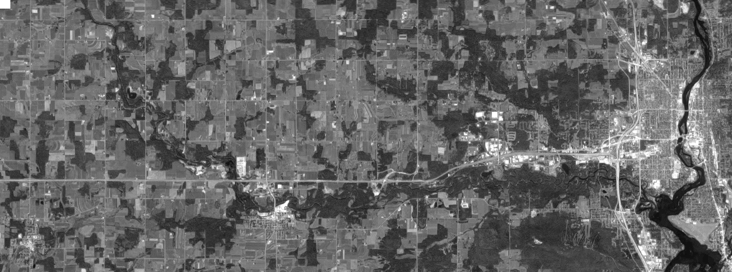
It Might One Day Receive Wastewater from Edgar and Marathon City
Marathon City
Wausau
Edgar
Schofield

Slide 7
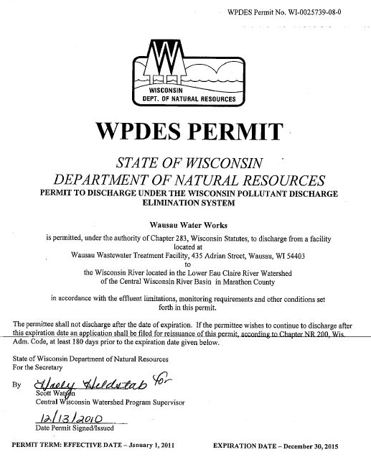
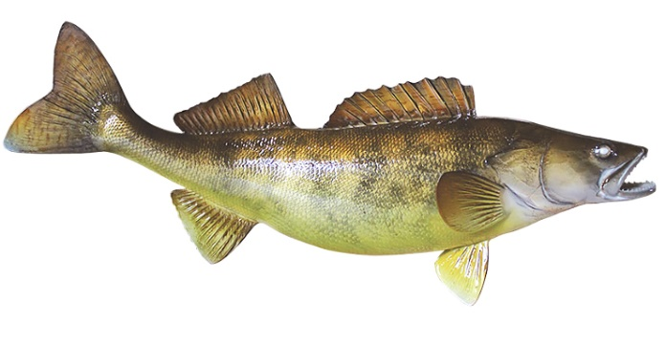
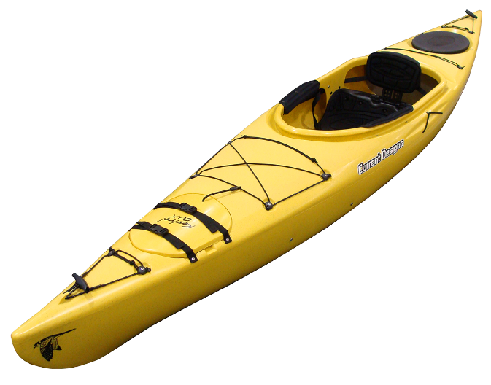
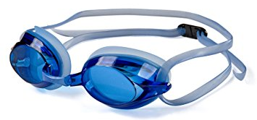
It Cleans and Disinfects the Wastewater
Produces Clean Water
  Disinfects
  Removes Debris
  Removes Oxygen-Consuming Material
  Removes Phosphorus

Slide 8
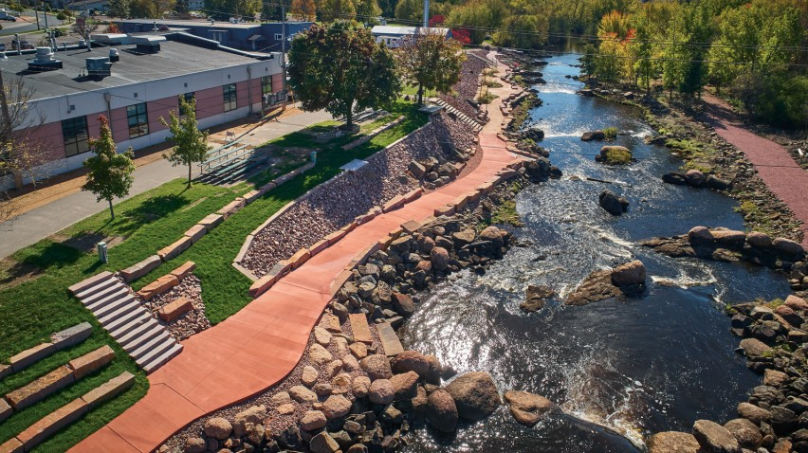
It Protects the Wisconsin River

Slide 9


It Reclaims Nutrients and Produces a Soil Amendment
Nutrient
Recovery
Nutrient
Reuse

Slide 10
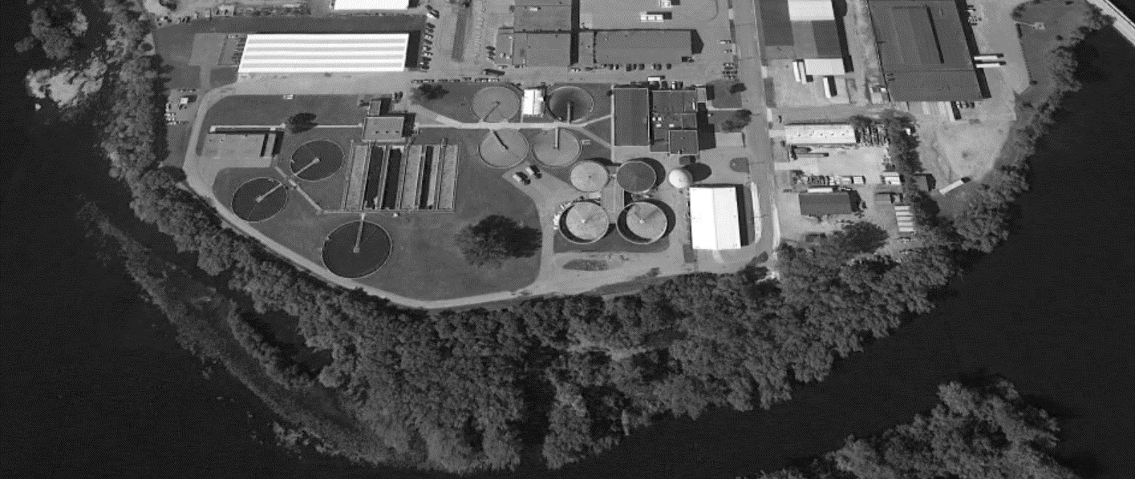
It’s a Resource Recovery Facility
Clean Water
Nutrients
Energy

Slide 11
It’s One of Wausau’s Most Valuable Assets
Potential Value = $175M*
* Based on recent new 24-mgd nutrient-removing treatment facility for Denver, CO. Grand opening 2017. Cost = $417M.
[CCI 2018 = 10,959. CCI 2011 = 9070. Cost = $504M in $2018. Includes a 7-mile forcemain.]

Slide 12
It Needs Improvements for Today and Future Generations
80 Years Old
Phase 1 1939
Phase 2 1967
Phase 3 1988
50 Years Old
30 Years Old

Slide 13
For Comprehensive Upgrades, EPA and WDNR Require a 20-Year Design Period
Upgrade Considerations
  Capacity
  Safety, Reliability, Performance
  Regulations
20
Years

Slide 14
The Facility will be 50 – 100 Years Old at the End of the Design Period
100 Years Old
Phase 1 1939
Phase 2 1967
Phase 3 1988
70 Years Old
50 Years Old

Slide 15
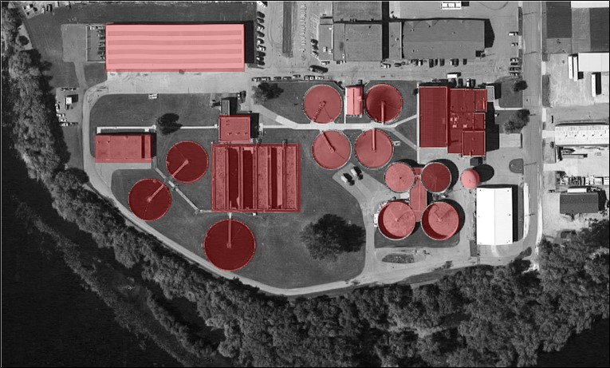
The Issues are Pervasive; However, the Facility Offers Tremendous Value
Capacity
  Disinfection
  Biosolids
Safety, Reliability, Performance
  Pervasive
  Revised Safety Standards
Regulations
  Phosphorus

Slide 16
The Facility is One of the Most Valuable City-Owned Assets
Foremost Objectives
  Maximize Benefit of Existing Infrastructure
  Maximize Return on Previous Investment

Slide 17
Realizing the Objective: Maximizing Use of Existing Infrastructure and Previous Investments
Rehabilitate
Repurpose
New
Do Nothing

Slide 18
The Project Schedule and Milestones

Slide 19
The Project Implementation Schedule
CWFP Application
Plans and Specs
Sep 30
Bids
CWFP Intent to Apply
Oct 31
Loan Closing
First Loan Draw
Begin Loan Re-Payment
2018 |  |  |  | 2019 |  |  |  | 2020 |  |  |  | 2021 |  |  |  | 2022
Q1 | Q2 | Q3 | Q4 | Q1 | Q2 | Q3 | Q4 | Q1 | Q2 | Q3 | Q4 | Q1 | Q2 | Q3 | Q4 | Q1 | Q2 | Q3 | Q4
Draft Facility Plan
Preliminary Design
Detailed Design
Bid
Construction
Phased Rate Increase

Slide 20
The Project Implementation Schedule
CWFP Application
Plans and Specs
Sep 30
Bids
CWFP Intent to Apply
Oct 31
Loan Closing
First Loan Draw
Begin Loan Re-Payment
2018 |  |  |  | 2019 |  |  |  | 2020 |  |  |  | 2021 |  |  |  | 2022
Q1 | Q2 | Q3 | Q4 | Q1 | Q2 | Q3 | Q4 | Q1 | Q2 | Q3 | Q4 | Q1 | Q2 | Q3 | Q4 | Q1 | Q2 | Q3 | Q4
Draft Facility Plan
Preliminary Design
Detailed Design
Bid
Construction
Most important phase: thoroughly defines the Project, its cost, and cost-reduction strategies
High cost resolution
High cost influence
Phased Rate Increase

Slide 21
The Project Implementation Schedule
CWFP Application
Plans and Specs
Sep 30
Bids
CWFP Intent to Apply
Oct 31
Loan Closing
First Loan Draw
Begin Loan Re-Payment
2018 |  |  |  | 2019 |  |  |  | 2020 |  |  |  | 2021 |  |  |  | 2022
Q1 | Q2 | Q3 | Q4 | Q1 | Q2 | Q3 | Q4 | Q1 | Q2 | Q3 | Q4 | Q1 | Q2 | Q3 | Q4 | Q1 | Q2 | Q3 | Q4
Draft Facility Plan
Preliminary Design
Detailed Design
Bid
Construction
The Project and its costs are defined at the completion of the Preliminary Design Phase
High cost resolution
High cost influence
Phased Rate Increase

Slide 22
The Preliminary Design Phase
The Project and Its Cost is Defined
Rate Implications are Defined
2018 |  |  |  |  |  | 2019
Q3 |  |  | Q4 |  |  | Q1
Jul | Aug | Sep | Oct | Nov | Dec | Jan | Feb | Mar
Process Design and Conceptual Layout Drawings
Preliminary Layout Drawings
Cost Refinement
Detailed Design

Slide 23
The Project Funding Strategy

Slide 24
The Wisconsin Clean Water Fund Program (CWFP)
Financial assistance to Wisconsin municipalities for wastewater and storm water infrastructure projects
The Federal Program is 30+ Years Old
$118.7 billion to municipalities thru 38,450 low-interest loans since 1987

Slide 25
The Wisconsin Clean Water Fund Program (CWFP)
Financial assistance to Wisconsin municipalities for wastewater and storm water infrastructure projects
Combination of federal grants and state funding in the form of subsidized loans
  55% of Market Rate (3.4%)
  Interest Rate = 1.87% for 20-yr term
  30-yr term may be slightly higher…Wausau a case study for WDNR to develop 30-yr option
The Federal Program is 30+ Years Old
$118.7 billion to municipalities thru 38,450 low-interest loans since 1987

Slide 26
Several Things Need to be Done in Near-Term to Preserve Eligibility for CWFP
Pass Reimbursement Resolution

Slide 27
Several Things Need to be Done in Near-Term to Preserve Eligibility for CWFP
Pass Reimbursement Resolution
  Allows for cost reimbursement up to 20% of loan amount – e.g., planning, design, land, early improvements that cant wait

Slide 28
Several Things Need to be Done in Near-Term to Preserve Eligibility for CWFP
Pass Reimbursement Resolution
  Allows for cost reimbursement up to 20% of loan amount – e.g., planning, design, land, early improvements that cant wait
Designate Authorized Representative

Slide 29
Several Things Need to be Done in Near-Term to Preserve Eligibility for CWFP
Pass Reimbursement Resolution
  Allows for cost reimbursement up to 20% of loan amount – e.g., planning, design, land, early improvements that cant wait
Designate Authorized Representative
  Identifies the person authorized to submit materials to CWFP

Slide 30
Several Things Need to be Done in Near-Term to Preserve Eligibility for CWFP
Pass Reimbursement Resolution
  Allows for cost reimbursement up to 20% of loan amount – e.g., planning, design, land, early improvements that cant wait
Designate Authorized Representative
  Identifies the person authorized to submit materials to CWFP
Submit Intent to Apply (ITA)

Slide 31
Several Things Need to be Done in Near-Term to Preserve Eligibility for CWFP
Pass Reimbursement Resolution
  Allows for cost reimbursement up to 20% of loan amount – e.g., planning, design, land, early improvements that cant wait
Designate Authorized Representative
  Identifies the person authorized to submit materials to CWFP
Submit Intent to Apply (ITA)
  Gets Wausau on the list of communities that may use the CWFP funding in SFY 2020 (Project Priority List)
    Due Oct 31, 2018
    SFY 2020 = Jul 1, 2019 – Jun 30, 2020

Slide 32
Preliminary Design Phase and Next Steps
Reimbursement and Authorized Representative Resolutions
Commission, Finance, and Council Update
Reimbursement Resolution
Authorized Representative Resolution
2018 |  |  |  |  |  | 2019
Q3 |  |  | Q4 |  |  | Q1
Jul | Aug | Sep | Oct | Nov | Dec | Jan | Feb | Mar
Process Design and Conceptual Layout Drawings
Preliminary Layout Drawings
Cost Refinement
Detailed Design

Slide 33
Preliminary Design Phase and Next Steps
Authorization to Submit ITA
Commission, Finance and Council Update
Authorization to Submit Intent to Apply
2018 |  |  |  |  |  | 2019
Q3 |  |  | Q4 |  |  | Q1
Jul | Aug | Sep | Oct | Nov | Dec | Jan | Feb | Mar
Process Design and Conceptual Layout Drawings
Preliminary Layout Drawings
Cost Refinement
Detailed Design

Slide 34
Preliminary Design Phase and Next Steps
Cost Refinement
Commission and Staff Evaluate Project Costs and Value
Define the Recommended Project and What It Costs
2018 |  |  |  |  |  | 2019
Q3 |  |  | Q4 |  |  | Q1
Jul | Aug | Sep | Oct | Nov | Dec | Jan | Feb | Mar
Process Design and Conceptual Layout Drawings
Preliminary Layout Drawings
Cost Refinement
Detailed Design

Slide 35
Preliminary Design Phase and Next Steps
The Recommended Project Defined
Present the Recommended Project to Council and Public
The Recommended Project and What It Costs
Authorization to Proceed
2018 |  |  |  |  |  | 2019
Q3 |  |  | Q4 |  |  | Q1
Jul | Aug | Sep | Oct | Nov | Dec | Jan | Feb | Mar
Process Design and Conceptual Layout Drawings
Preliminary Layout Drawings
Cost Refinement
Detailed Design

Slide 36
The Project Implementation Schedule
CWFP Application
Plans and Specs
Sep 30
Bids
CWFP Intent to Apply
Oct 31
Loan Closing
First Loan Draw
Begin Loan Re-Payment
2018 |  |  |  | 2019 |  |  |  | 2020 |  |  |  | 2021 |  |  |  | 2022
Q1 | Q2 | Q3 | Q4 | Q1 | Q2 | Q3 | Q4 | Q1 | Q2 | Q3 | Q4 | Q1 | Q2 | Q3 | Q4 | Q1 | Q2 | Q3 | Q4
Draft Facility Plan
Preliminary Design
Detailed Design
Bid
Construction
Phased Rate Increase

Slide 37
Preliminary Project Budget and Rate Perspective

Slide 38
Primary Revenue Sources for Wausau Wastewater Utility

Slide 39
The Structure of a Residential Wastewater Bill
Residential Wastewater Bill
Use-Based Cost = $2.59/100 cubic Fee
Fixed Cost = $17/quarter

Slide 40
Comparison of Current Monthly Residential
Wastewater Bills [37.4 kgpy]

Slide 41
Planning-Level Project Costs
No Regionalization
$80M

Slide 42
Planning-Level Project Costs With Regionalization
$85M [$5M by Regional Communities]

Slide 43
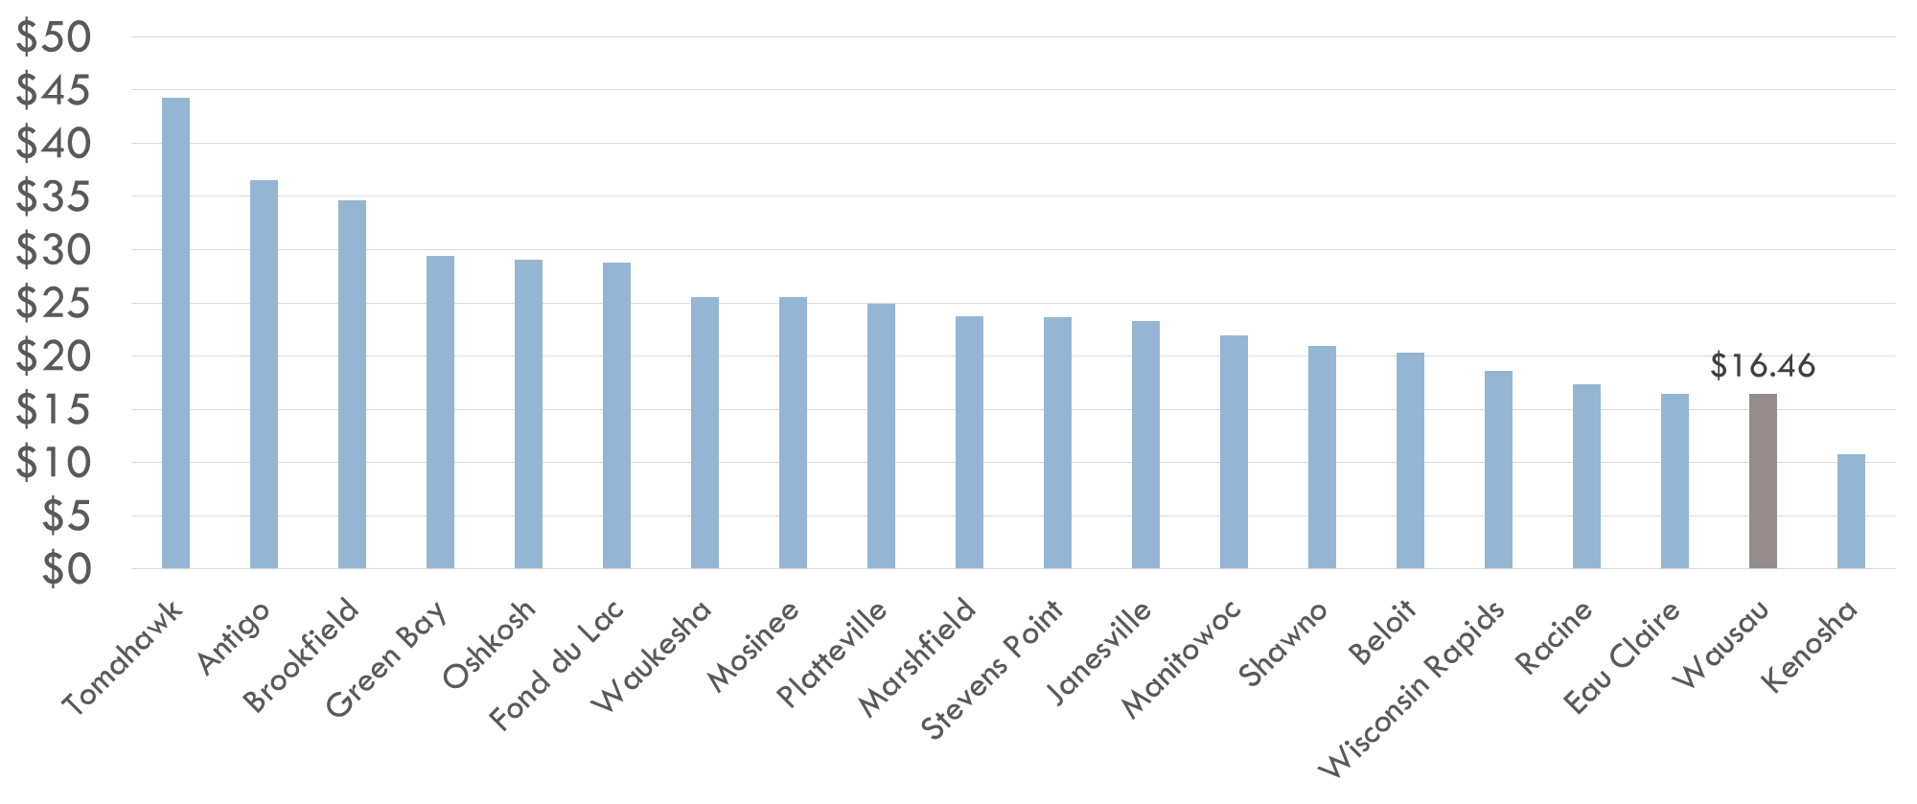
Comparison of Current Monthly Residential
Wastewater Bills [37.4 kgpy]
Last Major Upgrade 1988

Slide 44
Typical Monthly Increase to Residential Wastewater Bill
Most Probable for Budgetary Purposes

Slide 45
Comparison of Future Monthly Residential
Wastewater Bills [37.4 kgpy]
$16.5 + $13 = $29.50

Slide 46
Comparison of Future Monthly Residential
Wastewater Bills [37.4 kgpy]
EPA Affordability (2% of MHI) for Wausau ($67/mo)
Some WI Residents Paying this or More
$16.5 + $13 = $29.50

Slide 47
Preliminary Design Phase and Next Steps
The Recommended Project Defined
Present the Recommended Project to Council and Public
The Recommended Project and What It Costs
Authorization to Proceed
2018 |  |  |  |  |  | 2019
Q3 |  |  | Q4 |  |  | Q1
Jul | Aug | Sep | Oct | Nov | Dec | Jan | Feb | Mar
Process Design and Conceptual Layout Drawings
Preliminary Layout Drawings
Cost Refinement
Detailed Design

Slide 48
Regionalization Cost Scenarios

Slide 49
It Might One Day Receive Wastewater from Edgar and Marathon City
Marathon City
Wausau
Edgar
Schofield

Slide 50
Cost Summary of Regionalization Alternatives
[Costs in $M]
[Only Costs to Use Wausau WWTF and Collection System]

Slide 51
Questions
?

Slide 52
Thank You

Slide 53
Benefits of Preliminary Design Phase

Slide 54
Opportunity to Influence Cost
Influence
Planning
Preliminary Layout Design
Final Layout Design
Detailed Design
Construction
Project Phases

Slide 55
Cost Opinion Accuracy
Planning
Preliminary Layout Design
Final Layout Design
Detailed Design
±30%
±20%
±15%
±10%
Cost
Project Phases

Slide 56
Regionalization Details

Slide 57
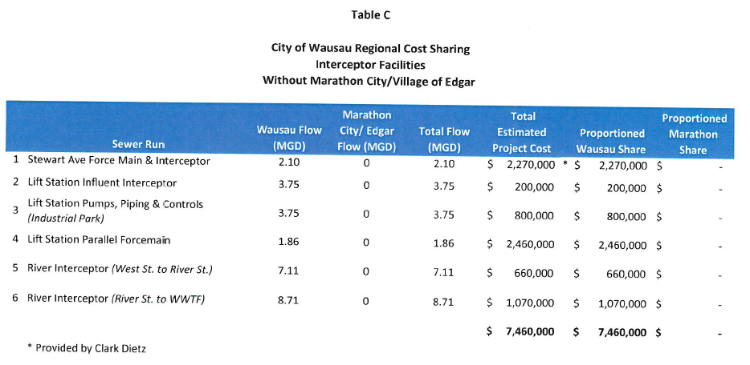

Slide 58
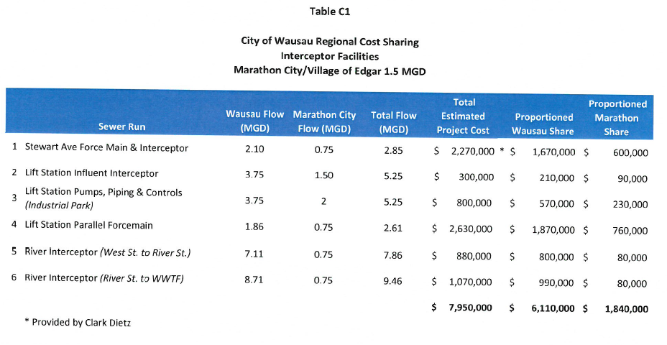

Slide 59
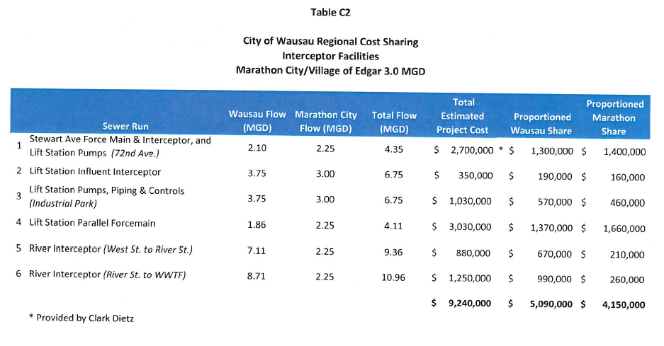

Slide 60
