Slide 1


A Wastewater Project Update
Utility Commission
Wausau, WI
September 4, 2018

Slide 2
The Wisconsin Clean Water Fund Program (CWFP)
Financial assistance to Wisconsin municipalities for wastewater and storm water infrastructure projects
Combination of federal grants and state funding in the form of subsidized loans
  55% of Market Rate (3.4%)
  Interest Rate = 1.87% for 20-yr term
  30-yr term may be slightly higher…Wausau a case study for WDNR to develop 30-yr option
The Federal Program is 30+ Years Old
$118.7 billion to municipalities thru 38,450 low-interest loans since 1987

Slide 3
Comparison of Current Monthly Residential
Wastewater Bills [37.4 kgpy]

Slide 4
Comparison of Future Monthly Residential
Wastewater Bills [37.4 kgpy]
$16.5 + $13 = $29.50

Slide 5
The Structure of a Residential Wastewater Bill
Residential Wastewater Bill
Use-Based Cost = $2.59/100 cubic Fee
Fixed Cost = $17/quarter

Slide 6

Proposed Sewer Rate Increase

Slide 7
Primary Revenue Sources for Wausau Wastewater Utility

Slide 8
Average Residential User

Slide 9
Actual Residential User - LINDMAN

Slide 10
The Project Implementation Schedule
CWFP Application
Plans and Specs
Sep 30
Bids
CWFP Intent to Apply
Oct 31
Loan Closing
First Loan Draw
Begin Loan Re-Payment
2018 |  |  |  | 2019 |  |  |  | 2020 |  |  |  | 2021 |  |  |  | 2022
Q1 | Q2 | Q3 | Q4 | Q1 | Q2 | Q3 | Q4 | Q1 | Q2 | Q3 | Q4 | Q1 | Q2 | Q3 | Q4 | Q1 | Q2 | Q3 | Q4
Draft Facility Plan
Preliminary Design
Detailed Design
Bid
Construction
Phased Rate Increase

Slide 11
Thank You

Slide 12
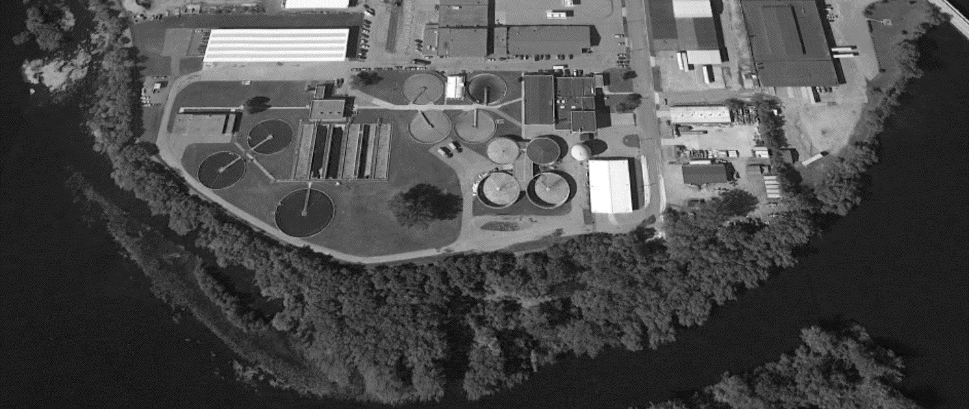
Realizing the Objective: Maximizing Use of Existing Infrastructure and Previous Investments
Rehabilitate
Repurpose
New
Do Nothing
QUESTIONS?

